Slide 1
Batch 5 : Team 5
Banking Website

Slide 2
Project overview
This is a banking application made using React Front-end and Java-Spring boot backend and MySQL database. Application allows the customer to register themselves, create accounts, withdraw/deposit money into accounts , transact money and view their current account’s balance.
Apart from this , the app offers certain admin specific functionalities for bank employees who can register themselves, search for details of a particular account / customer , activate/suspend account of a particular customer, view the entire transaction history of a particular account or customer

Slide 3
Features

Slide 4
Customer Dashboard
Register customer
Authentication with customer id and password
Create account
Withdraw / Deposit money
Fund transfer between accounts
View transaction history
Check bank balance
Add and update personal details
Log out

Slide 5
Admin Dashboard
Register admin
Authentication with admin id and password
Create account for a specific user
View all account details of a specific user
View all transaction history of a given customer or account
View the customer personal information
Check bank balance of all customer’s accounts
Activate or suspend a particular account
Log out

Slide 6
Tech Stack

Slide 7
Frontend
React js
Axios
Bootstrap
Cdbreact
Font-awesome
React sweet alerts
React router dom
React hook form
React select

Slide 8
Backend
Spring Boot
My SQL Database
Spring Test

Slide 9
Uml Diagram

Slide 10
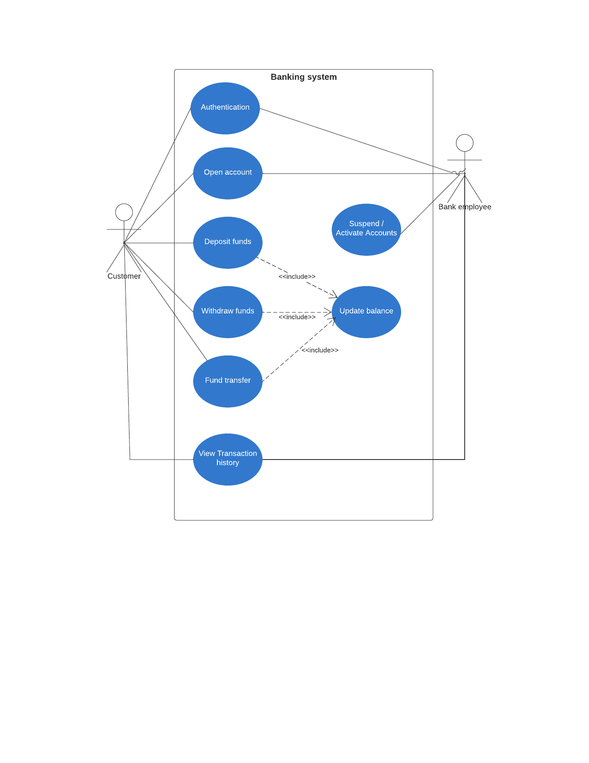

Slide 11
Major features implementation

Slide 12
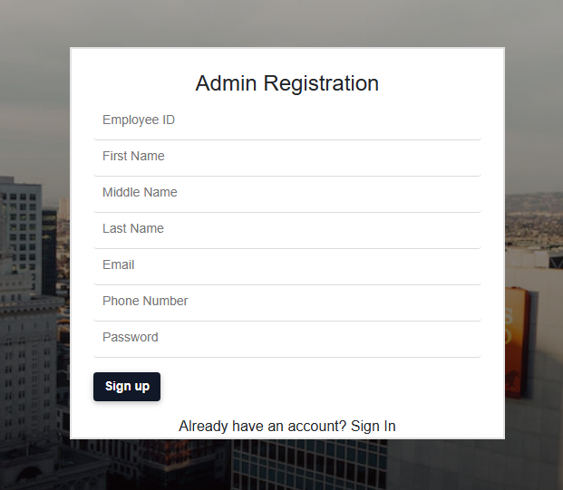
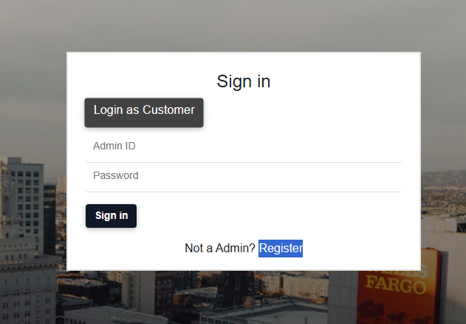
Authentication

Slide 13
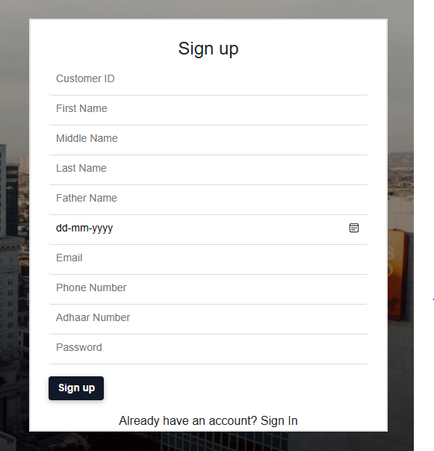
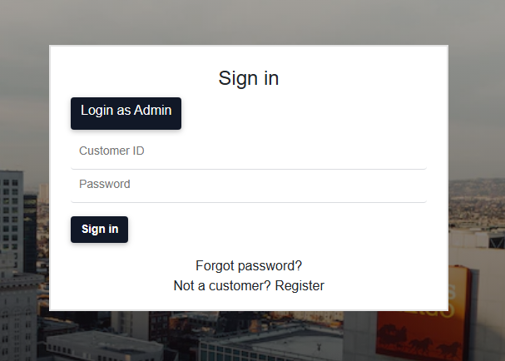

Slide 14
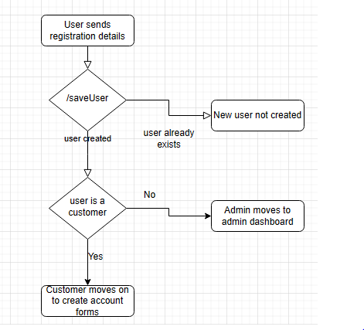
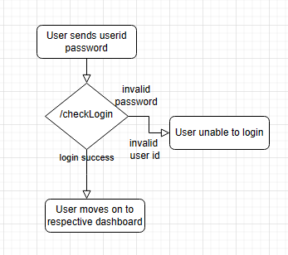

Slide 15
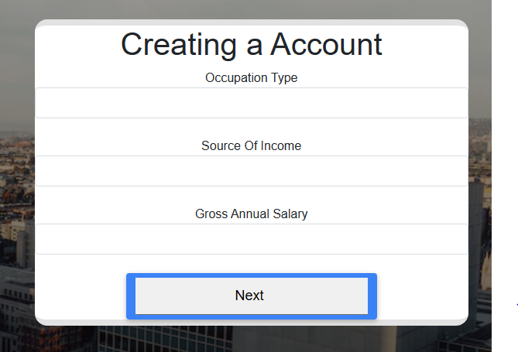
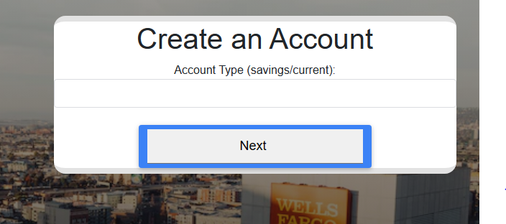
Create Account

Slide 16
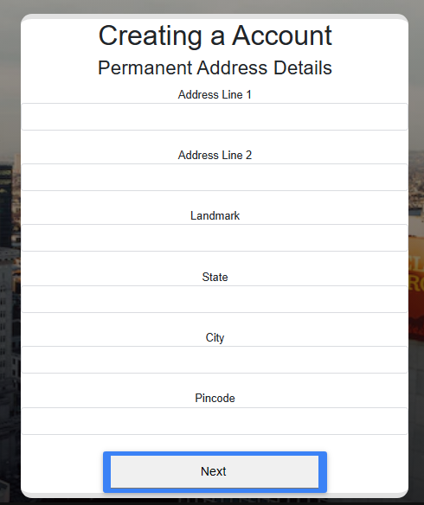
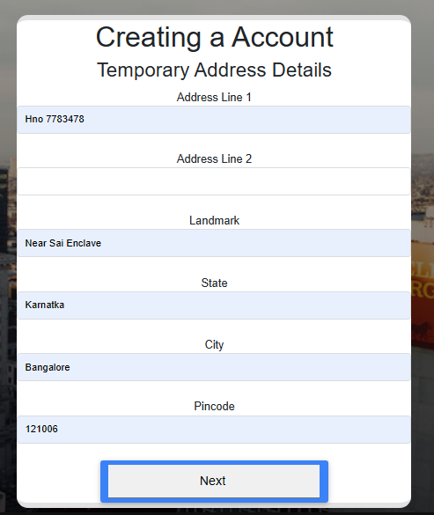

Slide 17
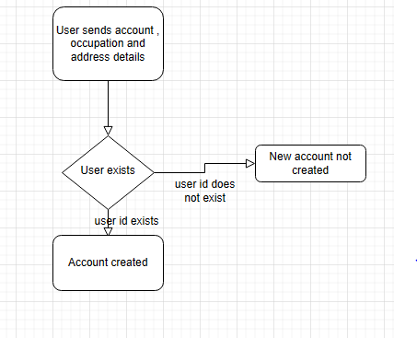

Slide 18
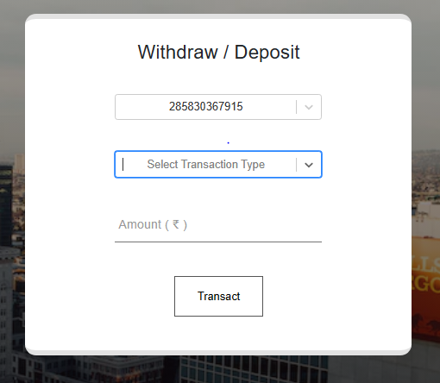
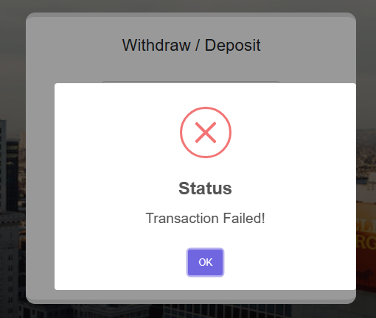
Transactions

Slide 19
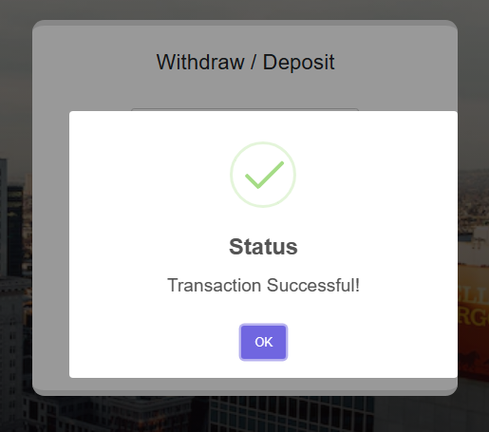
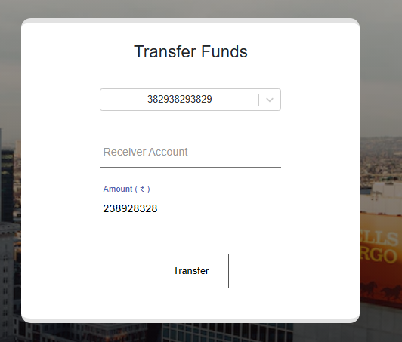

Slide 20
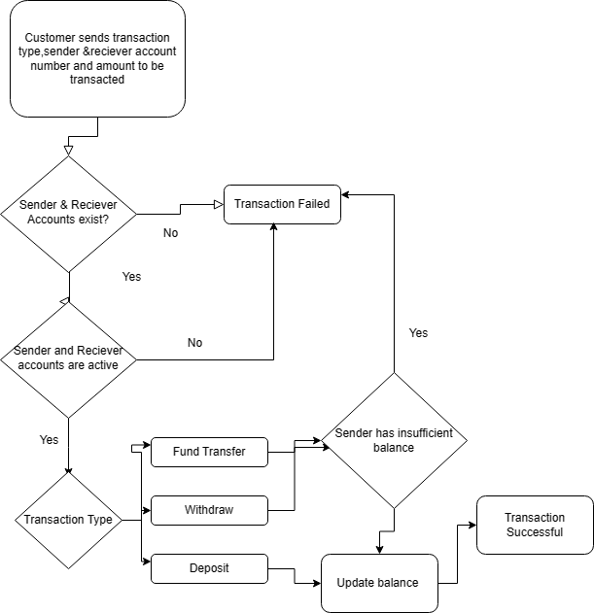

Slide 21
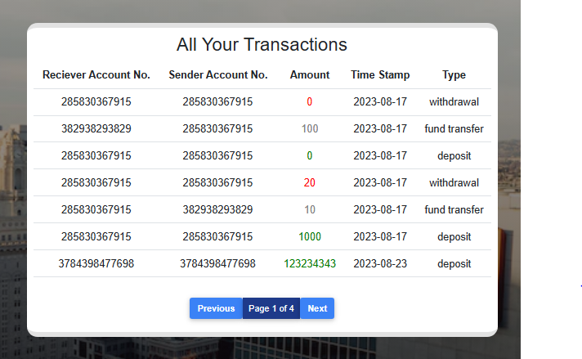
Transactions History

Slide 22
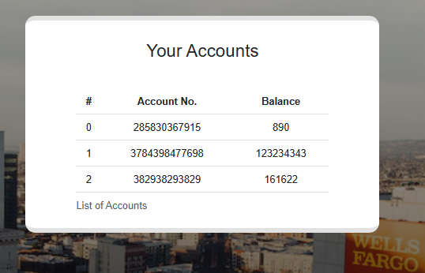
Check Account Balance

Slide 23
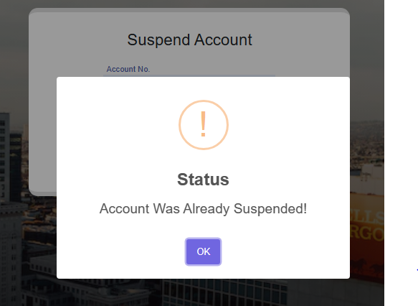
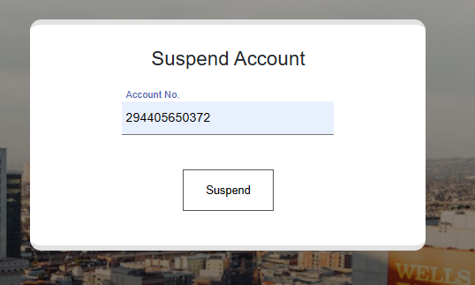
Suspend Account

Slide 24
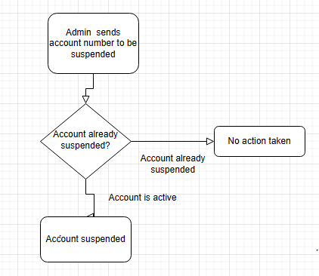

Slide 25
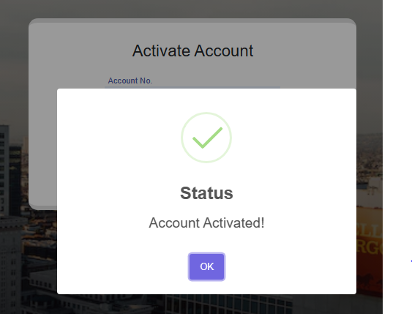
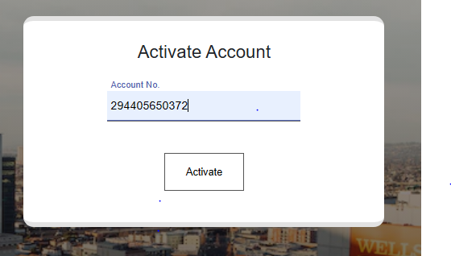
Activate Account

Slide 26
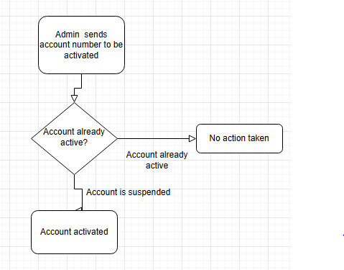

Slide 27
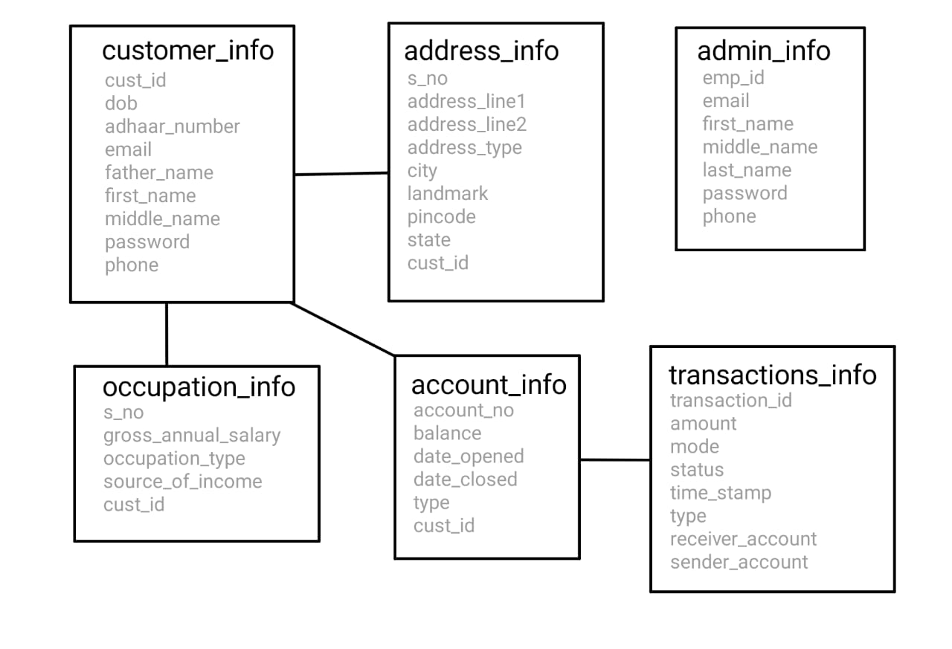
ER Diagram

